Slide 1
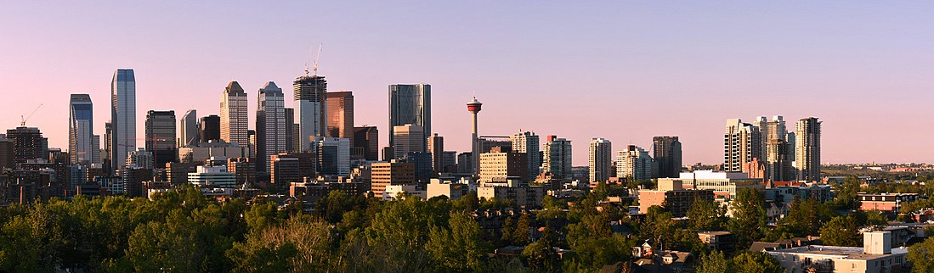
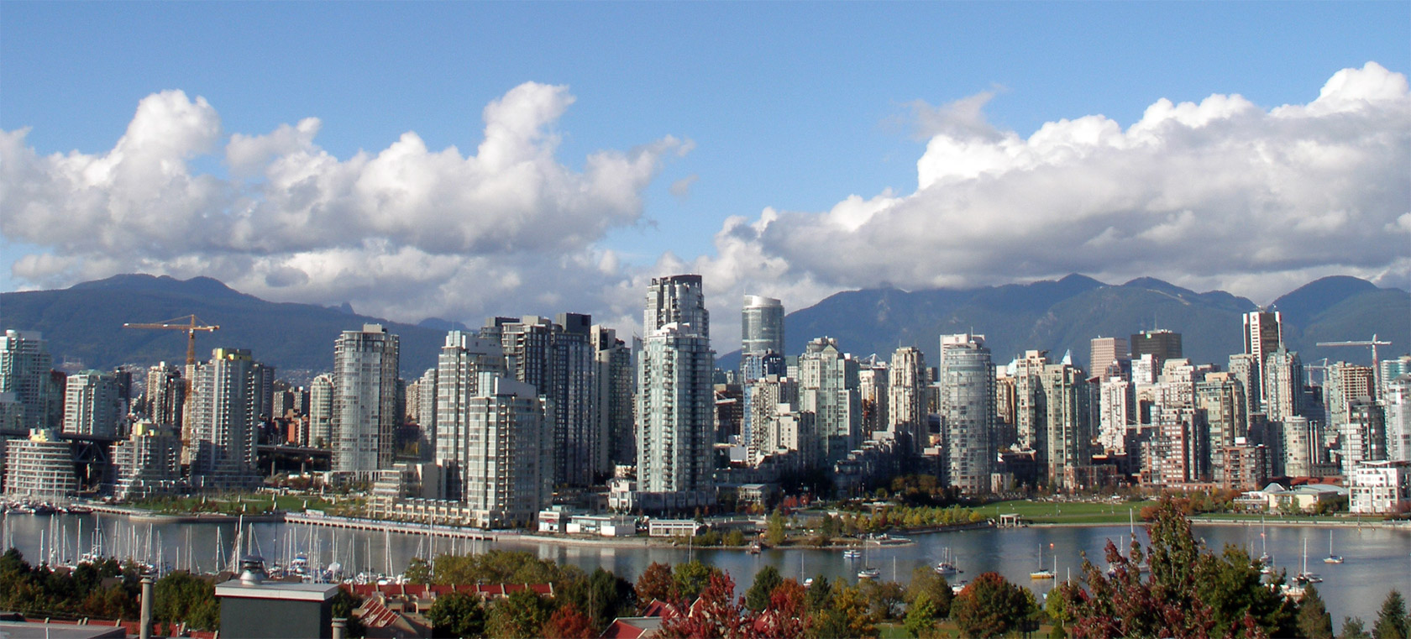
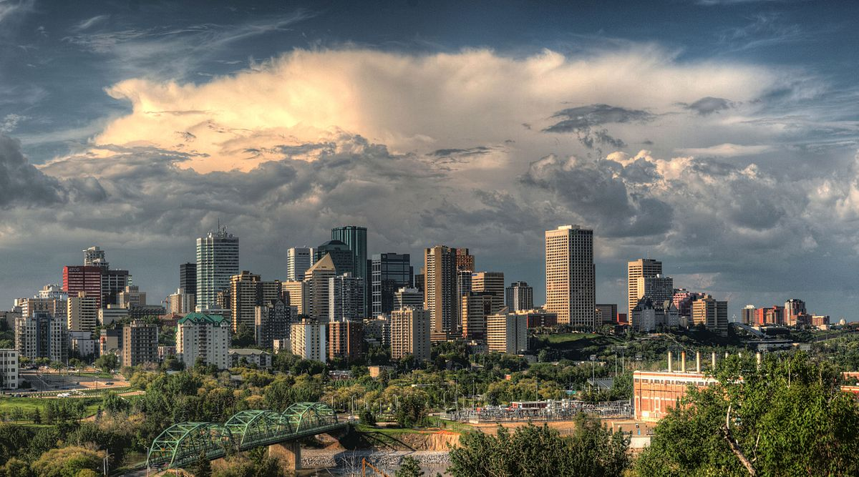

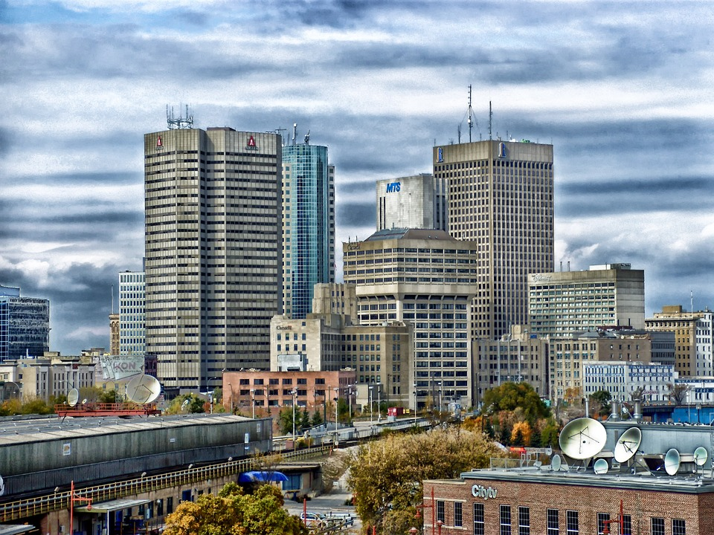
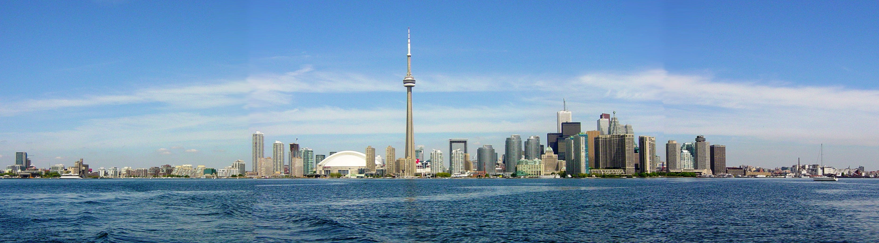
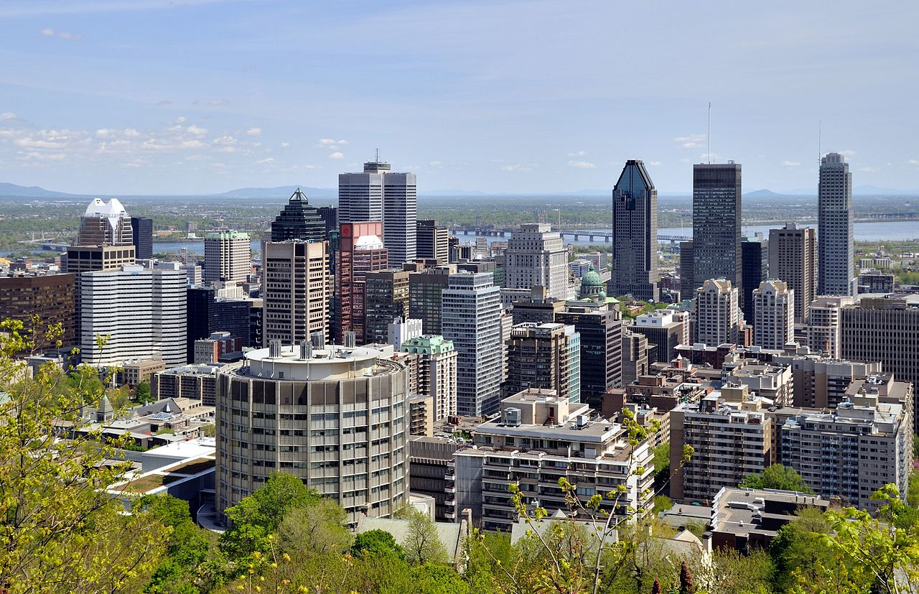
Dissimilarity Between Canadian Urban Centers
Using Python and Cluster Analysis to Compare Canadian Cities
This Photo by Unknown Author is licensed under CC BY-ND

Slide 2
Problem/Introduction
Canada is described as a very regional defined country. The country is easily divided into distinct areas.
The Maritimes, Quebec, Ontario, the prairie provinces, and British Columbia.
Despite being the second largest country in the world by area, it is an urbanized country with more than 80% of the population living in cities.
Contrasting with the perception of a fragmented region-based country, cities are considered sterile and uniform. Which is it?
If we compare amenities available to each of the major cities in Canada, will we determine that all cities are the same, or are there clusters of similar amenities in each FSA (forward sortation area) in each city that differentiates them from each other.
This assignment will attempt to use Python, foursquare, and a variety of cartographic and analytics approaches to answer that question.

Slide 3
Data
All postal codes (FSA) and a somewhat meaty list of community names are available through Wikipedia. Frustratingly, Toronto (the sample demonstrated in the course material) is unique in its structure and format. Fortunately, every other province is consistent. Once the method for scraping was figured, it could be replicated.
- All FSA data is being scraped from Wikipedia and processed using BeautifulSoup.
- Geographic information for FSAs can be obtained from Statistics Canada, the shapefile was downloaded from:
https://www150.statcan.gc.ca/n1/en/catalogue/92-179-X
- The FSA centroids were downloaded from Geogratis: http://geogratis.gc.ca/services/geolocation/en/locate?q

Slide 4
Methodology
All FSAs that correspond to one of Canada's major cities were scraped from Wikipedia.
Vancouver, Calgary, Edmonton, Winnipeg, Toronto, and Montreal were selected for analysis.
FSA data was combined with amenity data from foursquare for each FSA
Spatial information was added via geographic centroids of each FSA courtesy of Geogratis and the polygon shapefile from statistics Canada.
The ten most common amenity types were determined for each FSA.
The FSAs were clustered using K-means clustering to determine dissimilarity.
The results were visualized cartographically using geopandas.

Slide 5
Hypothesis
Null Hypothesis
There is no difference between cities of different regions, the cluster algorithm will show similar results from city to city.

Slide 6
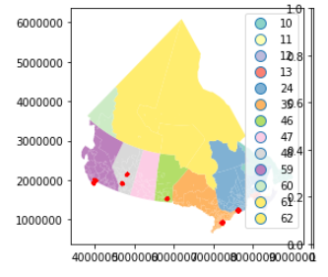
Exploratory Analysis
First stage is validating that the cities scraped correspond to the geographic locations of the cities.

Slide 7
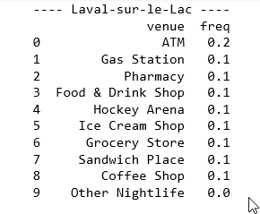
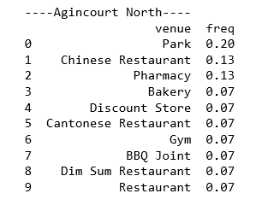
Exploratory Analysis
A quick check reveals that there are 14,057 records that have been pulled from foursquare, and there are 418 unique categories.
Laval and Agincourt have very different venues. Only #3 (Pharmacy) is consistent between the two top ten lists.
No other entry appears in both.

Slide 8
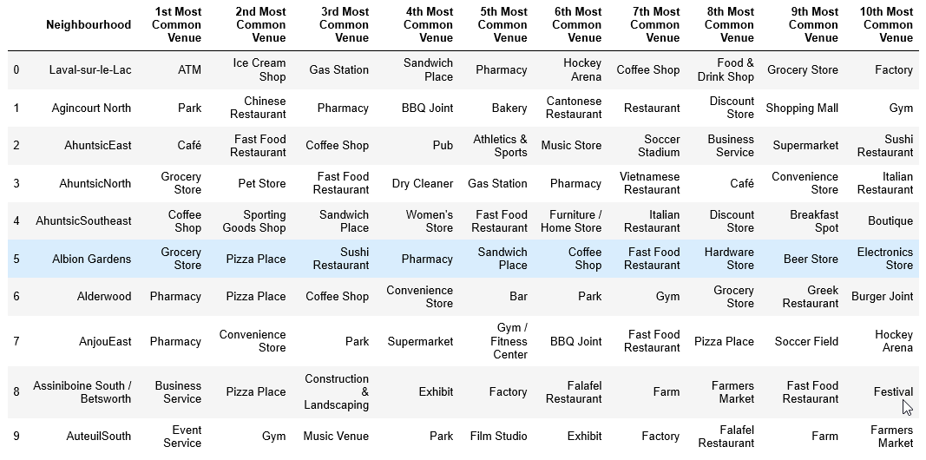
Exploratory Analysis
Each community appears quite unique, even in the same geographic clustering of neighbourhoods (Ahuntsic)

Slide 9
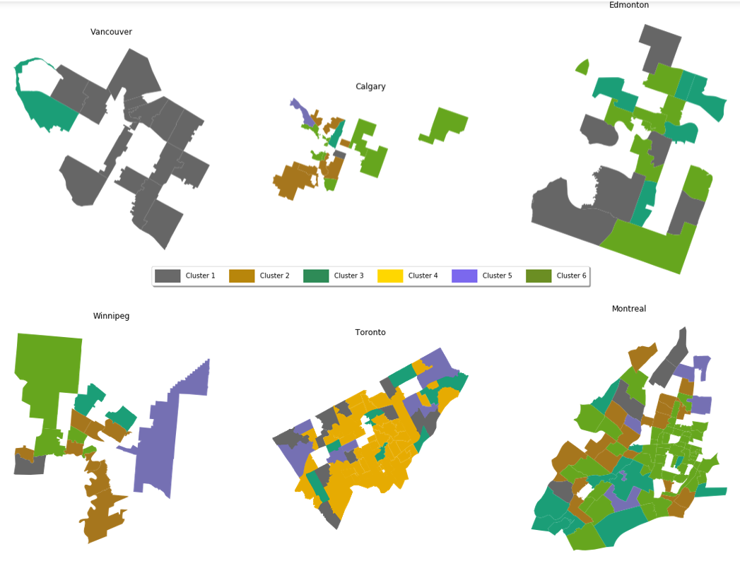
Results
Vancouver is nearly all Cluster 1
Calgary is Cluster 2/6
Edmonton is Cluster 1/3/6
Winnipeg is mostly Cluster 2/6
Toronto is mostly Cluster 4
Montreal is diverse: Cluster 2/3/5/6

Slide 10
Discussion
Cities are in many cases homogenous entities within themselves, with frequent patterns.
Canadian cities do vary with regional tendencies
Vancouver is represented almost uniformly by a single cluster, as is Toronto, but with a different cluster distinct from all other cities.
Prairie cities (Calgary, Edmonton, and Winnipeg) display some commonalities, but nevertheless are distinct.
Amenity availability seems to vary more between cities than within them.

Slide 11
Conclusions
Services available in Canadian cities vary by region
Cities within the same region demonstrate more similar characteristics
Cities have an identity and generally display only consistent variation within themselves (no city had more than 4/6 clusters)
Marketing and politicians should be aware of the distinct flavours and personalities of the cities with which they are communicating.

